Slide 1
Lessons Learned From Agile Quality Assurance In Scrum

Slide 2
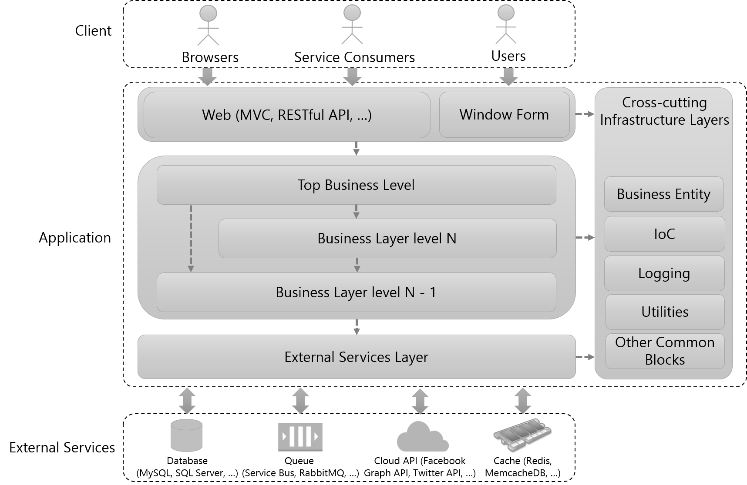
The conceptual structure of an application to software testing

Slide 3
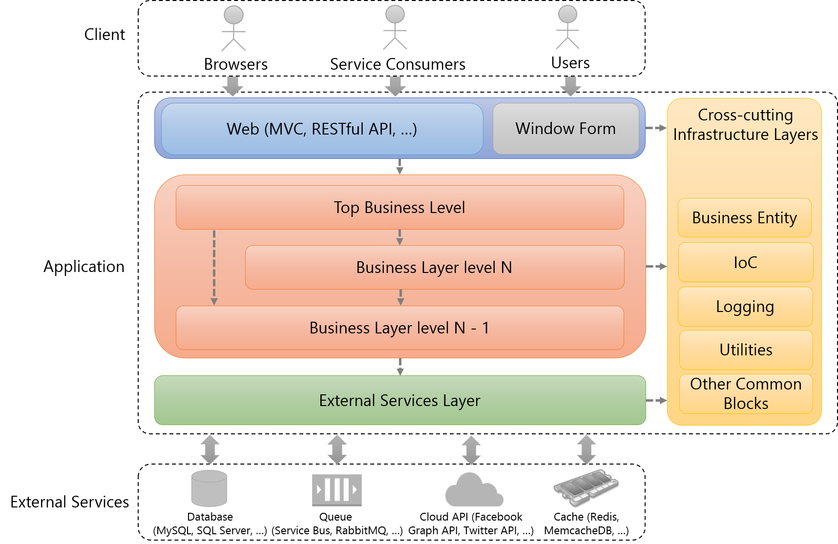
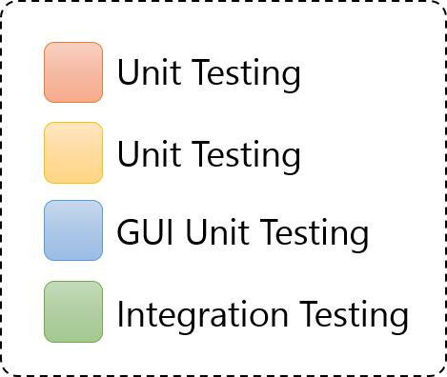

The conceptual structure of an application to software testing
Software components are covered by types of testing
Each component is covered by a type of testing individually

Slide 4

The conceptual structure of an application to software testing
How do we test the entire application?

Slide 5
The conceptual structure of an application to software testing
System Testing
Automated System Testing
Manual System Testing
End-To-End Testing
Integration Testing

Slide 6


The conceptual structure of an application to software testing
End-To-End Testing
System Integration Testing
Simulate real user scenarios to test the entire application.
Call the top business level to test the application.
The entire application is tested for critical functionalities.
Only business logic is tested for critical functionalities.
we prefer “end-to-end testing” rather than “system integration testing”

Slide 7
DEMO

Slide 8
What types of testing should be performed to ensure software quality?
Unit Testing
GUI Unit Testing
Integration Testing
System Testing (Manual System Testing, Automated System Testing)

Slide 9
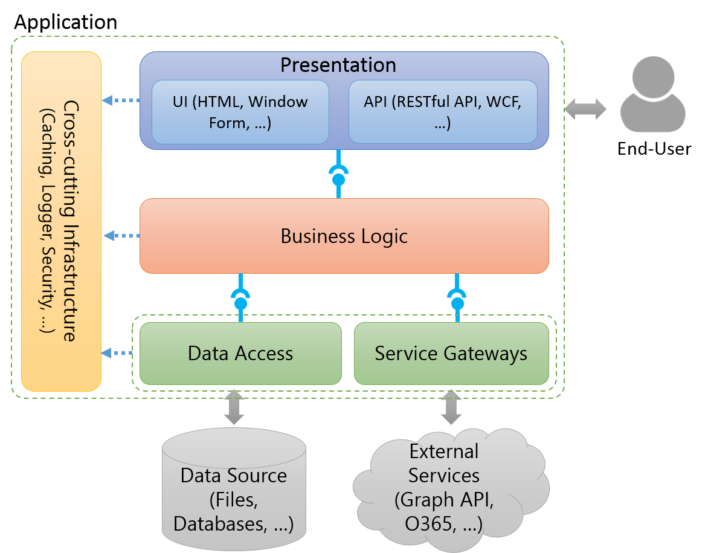
The conceptual structure of an application to software testing
Notes:
To talk something about the conceptual structure of an application to show to audiences the structure which is applied in almost applications.

Slide 10
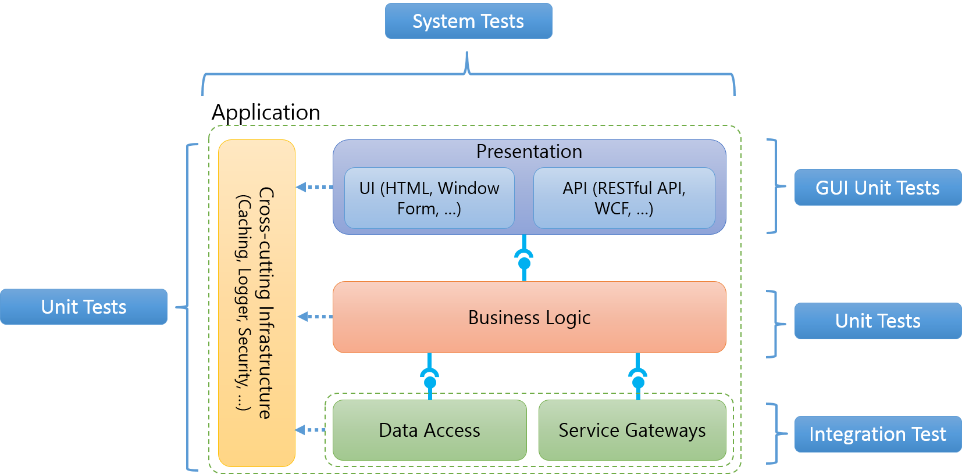
The conceptual structure of an application to software testing
Notes:
To indicate what aspects of an application are covered which types of test (Ex: Business Logic is covered by unit tests.)

Slide 11

Application
Cross-cutting Infrastructure
(Caching, Logger, Security, …)
Presentation
UI (HTML, Window Form, …)
API (RESTful API, WCF, …)
End-User
Business Logic
Data Access
Service Gateways
Data Source (Files, Databases, …)
External Services (Graph API, O365, …)

Slide 12
System Tests
Application
Cross-cutting Infrastructure
(Caching, Logger, Security, …)
Presentation
UI (HTML, Window Form, …)
API (RESTful API, WCF, …)
GUI Unit Tests
Unit Tests
Business Logic
Unit Tests
Data Access
Service Gateways
Integration Test
Notes:
http://blogs.msdn.com/b/jmeier/archive/2008/11/24/application-architecture-diagrams-added-to-codeplex.aspx

Slide 13




Client
Browser
Web Server
Business Entity
Presentation
Cross-cutting Infrastructure
UI (MVC, Window Form, …)
API (RESTful API, WCF, …)
Configuration
Business Logic
Logging
Utilities
Service Gateways
Other Common Blocks
Database
(Cassandra, MongoDb, …)
Queue
(Service Bus, RabbitMQ, …)
Cloud API (Facebook Graph API, Twitter API, …)
Memcache (Redis, MemcacheDB, …)
Notes:
http://blogs.msdn.com/b/jmeier/archive/2008/11/24/application-architecture-diagrams-added-to-codeplex.aspx

Slide 14


Client
Browsers
Service Consumers
Users
Web (MVC, RESTful API, …)
Window Form
Cross-cutting Infrastructure Layers
Top Business Level
Business Entity
Application
Business Layer level N
IoC
Logging
Business Layer level N - 1
Utilities
External Services Layer
Other Common Blocks
External Services
Database
(MySQL, SQL Server, …)
Queue
(Service Bus, RabbitMQ, …)
Cloud API (Facebook Graph API, Twitter API, …)
Cache (Redis, MemcacheDB, …)

Slide 15
Client
Browsers
Service Consumers
Users
Web (MVC, RESTful API, …)
Window Form
Cross-cutting Infrastructure Layers
Top Business Level
Business Entity
Application
Business Layer level N
IoC
Logging
Business Layer level N - 1
Utilities
External Services Layer
Other Common Blocks
External Services
Database
(MySQL, SQL Server, …)
Queue
(Service Bus, RabbitMQ, …)
Cloud API (Facebook Graph API, Twitter API, …)
Cache (Redis, MemcacheDB, …)

Slide 16
Unit Testing
Unit Testing
GUI Unit Testing
Integration Testing

Slide 17
Simulate real user scenarios to test the entire application.
Client
Browsers
Service Consumers
Users
Web (MVC, RESTful API, …)
Window Form
Cross-cutting Infrastructure Layers
Top Business Level
Business Entity
Application
Business Layer level N
IoC
Logging
Business Layer level N - 1
Utilities
External Services Layer
Other Common Blocks
External Services
Database
(MySQL, SQL Server, …)
Queue
(Service Bus, RabbitMQ, …)
Cloud API (Facebook Graph API, Twitter API, …)
Cache (Redis, MemcacheDB, …)

Slide 18
Client
Browsers
Service Consumers
Users
Web (MVC, RESTful API, …)
Window Form
Cross-cutting Infrastructure Layers
Top Business Level
Business Entity
Application
Business Layer level N
IoC
Logging
Business Layer level N - 1
Utilities
External Services Layer
Other Common Blocks
External Services
Database
(MySQL, SQL Server, …)
Queue
(Service Bus, RabbitMQ, …)
Cloud API (Facebook Graph API, Twitter API, …)
Cache (Redis, MemcacheDB, …)

Slide 19
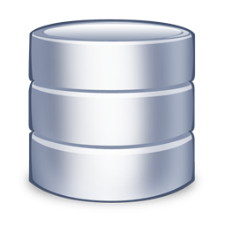
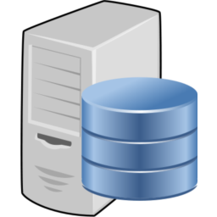

Source Repository
Build Server
Development Machine

